Slide 1

C Programming
06: summary and example（2）

Slide 2
character graphic
*
* *
* * *
* * * *
* * * * *
(1)
*
* *
* * *
* * * *
* * * * *
(2)
* * * * *
* * * *
* * *
* *
*
(3)
* * * * *
* * * *
* * *
* *
*
(4)
*
* * *
* * * * *
* * *
*
(7)
*
* * *
* * * * *
* * * * * * *
(5)
* * * * * * *
* * * * *
* * *
*
(6)

Slide 3
character graphic
#include "stdio.h"
void main()
{ int n,i,j;
printf("Input n=");
scanf("%d",&n);
for(i=1;i<=n;i++)
{ for(j=1;j<=i;j++) putchar('∗');
/∗ i asterisks ∗/
printf("\n");
/∗ new line ∗/
}
}
*
* *
* * *
* * * *
* * * * *
(1)
Solution:
For each row, there are
i asterisks
a new line.

Slide 4
character graphic
Solution:
For each row, there are:
n-i spaces
I asterisks
a new line.
*
* *
* * *
* * * *
* * * * *
(2)
for(i=1;i<=n;i++)
{ for(j=1;j<=n−i;j++) putchar(32); /∗ n-i spaces ∗/
for(j=1;j<=i;j++) putchar('∗'); /∗ i asterisks ∗/
printf("\n"); /∗ a new line ∗/
}

Slide 5
character graphic
* * * * *
* * * *
* * *
* *
*
(3)
Solution:
For each row, there are
n-i+1 asterisks
a new line.
for(i=1;i<=n;i++)
{
for(j=1;j<=n-i+1;j++) putchar('∗');
/∗ n-i+1 asterisks ∗/
printf("\n"); /∗ a new line ∗/
}

Slide 6
character graphic
Solution:
For each row, there are:
i-1 spaces
n-i+1 asterisks
a new line.
* * * * *
* * * *
* * *
* *
*
(4)
for(i=1;i<=n;i++)
{ for(j=1;j<=i-1;j++) putchar(32); /∗ i-1 spaces ∗/
for(j=1;j<=n-i+1;j++) putchar('∗');
/∗ n-i+1 asterisks ∗/
printf("\n"); /∗ a new line ∗/
}

Slide 7
character graphic
Solution:
For each row, there are:
n-i spaces
2*i+1 asterisks
a new line.
*
* * *
* * * * *
* * * * * * *
(5)
for(i=1;i<=n;i++)
{ printf("%∗s", i-1,"");
for(j=1;j<=2*i-1;j++) putchar('*');
printf("\n");
}
Statement for n-i spaces:
printf("%∗s",n−i,""); /* n-i列宽输出空串*/

Slide 8
character graphic
* * * * * * *
* * * * *
* * *
*
(6)
Solution？

Slide 9
character graphic
Solution:
For each row, there are:
i-1 spaces
2*(n-i)+1 asterisks
a new line.
* * * * * * *
* * * * *
* * *
*
(6)
for(i=1;i<=n;i++)
{ printf("%∗s", i-1,"");
for(j=1;j<=2*(n-i)+1;j++) putchar('*');
printf("\n");
}

Slide 10
*
* * *
* * * * *
* * *
*
(7)
Solution？

Slide 11
character graphic
1
22
333
4444
55555
(1)
Solution ?

Slide 12
Recursive iteration(递推迭代）
The recursion arithmetic is to use some steps of simple repeated calculation to describe the complex problems.

Slide 13
Recursive iteration
Type 1.
solution：s=0; for(i=0;i<n;i++) s+=a_{i};
solution ：p=1; for(i=0;i<n;i++) p∗=a_{i};

Slide 14
Recursive iteration
Type 2
a₀ (a known number) i=0
a_{i}=
f(i)·a_{i−1} i>0
solution：a=a₀; /*initializtion*/
a=f(i)∗a; /* i ( from 1 to n−1 )*/
iteration

Slide 15

Recursive iteration
Example1.
Calculate the approximate value of using the following formula, calculate until the absolute value of the last one is less than 10⁻⁶

Slide 16
Recursive iteration
i=1, 3, 5, 7, …
#include "stdio.h"
#include "math.h" /*why include math.h ？*/
void main() {
double a,pi;int i,s;
a=1.0;pi=0;s=1;i=1;
while(fabs(a)>1e−6) /* the condition*/
{ pi+=s∗a; i+=2; a=1.0/i; s= −s;
}
pi=pi∗4;printf("pi=%f\n",pi)
}

Slide 17
Recursive iteration
Exercise.
Calculate the value of s using the following formula, calculate until the absolute value of the last one is less than 10⁻⁶

Slide 18
Recursive iteration
#include "stdio.h"
#include "math.h"
void main()
{ double x,s,a;int k;
printf("Input x=");scanf("%lf",&x);
a=1;s=0;k=0;
while(fabs(a)>1e−6) { s+=a; k++; a∗=x/k; }
printf("s=%g\n",s);
}
result
Input x=0.5↵
s=1.64872

Slide 19
Recursive iteration
In mathematics, the Fibonacci numbers are the numbers in the following integer sequence, called the Fibonacci sequence, and characterized by the fact that every number after the first two is the sum of the two preceding ones
1 1 2 3 5 8 13 21 34 55 …

Slide 20
Recursive iteration
By definition, the first two numbers in the Fibonacci sequence are either 1 and 1, and each subsequent number is the sum of the previous two.
The sequence F_{n} of Fibonacci numbers is defined by the recurrence relation
1 1 2 3 5 8 13 21 34 55 …
F₁=F₂=1 (seed values)
F_{n}=F_{n−1}+F_{n−2}
n=3, 4, 5, 6, …

Slide 21
Recursive iteration
F₁=F₂=1
F_{n}=F_{n−1}+F_{n−2}
n=3, 4, 5, 6, …
initializtion: f1=1; f2=1; // f1←F_{n-2} ；f2←F_{n-1}
iteration1： f1=f1+f2; // f1←F_{n}=F_{n−2}+F_{n−1}
f2=f1+f2; // f2←F_{n+1}=F_{n}+F_{n−1}
//特点：每趟迭代项号增2
iteration 2： f2=f1+f2; // f2←F_{n}=F_{n−2}+F_{n−1}
f1=f2−f1; // f1←F_{n-1}=F_{n}−F_{n−2}
//特点：每趟迭代项号增1

Slide 22
Recursive iteration
#include "stdio.h "
void main()
{ long f1,f2;int k; // why long?
f1=f2=1;printf("%10ld%10ld",f1,f2);
for(k=3;k<=40;k++)
{ f2=f1+f2; f1=f2−f1; // iteration 2
printf("%10ld",f2);
if(k%4= =0) printf("\n");
}
}

Slide 23
Prime number
A prime number (or a prime) is a natural number greater than 1 that cannot be formed by multiplying two smaller natural numbers.
A natural number greater than 1 that is not prime is called a composite number.

Slide 24
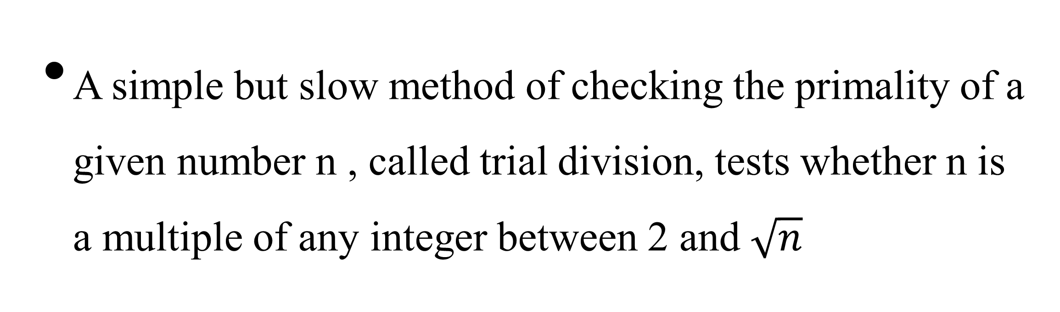
Prime number
A simple but slow method of checking the primality of a given number n , called trial division, tests whether n is a multiple of any integer between 2 and $\sqrt{n}$

Slide 25
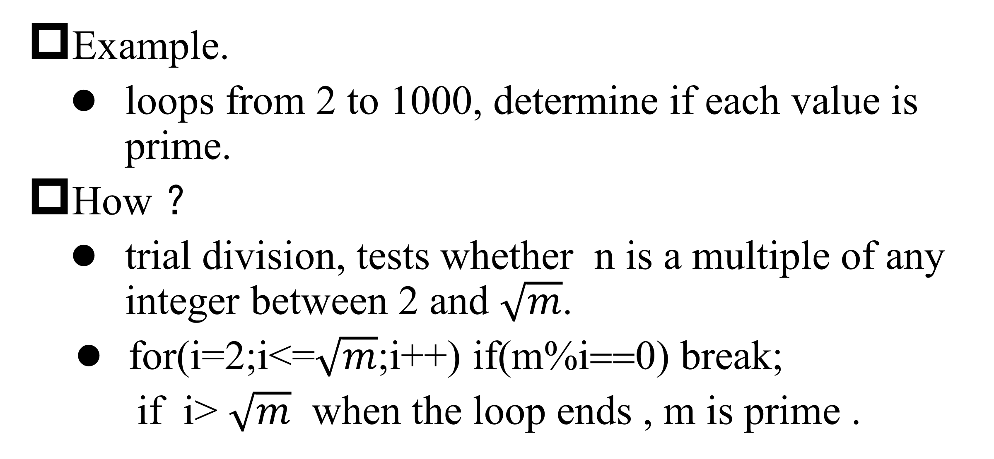
Prime number
Example.
loops from 2 to 1000, determine if each value is prime.
How ？
trial division, tests whether n is a multiple of any integer between 2 and $\sqrt{m}$.
for(i=2;i<=$\sqrt{m}$;i++) if(m%i==0) break;
if i> $\sqrt{m}$ when the loop ends , m is prime .

Slide 26
Prime number
#include "stdio.h"
#include "math.h"
void main() {
int m,k,sqrt_m,count=0;
for(m=2;m<=1000;m++)
{ sqrt_m=(int)sqrt(m)+1;
/∗ 加1是为了克服实数的表示误差 ∗/
for(k=2;k<=sqrt_m;k++) if(m%k= =0) break;
if(k>sqrt_m)
{ printf("%4d",m);count++;
if(count%10= =0) printf("\n");
/∗ 10 outputs for each line∗/
}
}
}

Slide 27
Exercise
Calculate the value of cos x using the following formula, input the value of x, calculate until the absolute value of the last one is less than 10⁻⁶

Slide 28
Exercise
Input a character ，print the character graphic as follows.
a
a b a
a b c b a
a b c d c b a
From Input

Slide 29
Exercise
Input n ，print the character graphic as follows.
1
3 5
7 9 11
13 15 17 19
n

Slide 30
Exercise
Input n ，print the character graphic as follows.
1 2 3 4 5
2 3 4 5 1
3 4 5 1 2
4 5 1 2 3
5 1 2 3 4
n=5

